Slide 1
Chongqing University of Technology
ATAI
Advanced Technique of Artificial Intelligence
Chongqing University of Technology
Self-Supervised Hypergraph Convolutional Networks for
Session-based Recommendation（AAA I_2021）
Xin Xia1, Hongzhi Yin, Junliang Yu1, Qinyong Wang1, Lizhen Cui, Xiangliang Zhang
The University of Queensland, Shandong University,
King Abdullah University of Science and Technology
xin.xia1@uqconnect.edu.au, {h.yin1, jl.yu, qinyong.wang}@uq.edu.au, clz@sdu.edu.cn, xiangliang.zhang@kaust.edu.sa
2021.1.17 • ChongQing
Reported by LeLe Duan
Code&dataset:https://github.com/xiaxin1998/DHCN.

Slide 2
Chongqing University of Technology
ATAI
Advanced Technique of Artificial Intelligence
Chongqing University of Technology
1.Background
2.Method
3.Experiments
4.Conclusion

Slide 3
Background
RNN-based SBR: Strictly and solely modeling the relative orders of items would probably make the recommendation models prone to overfitting.
GNNs-based SBR： Neglecting the complex high-order information among items.
DHCN: A novel SBR approach upon hypergraph to model the high-order relations among items within sessions.

Slide 4
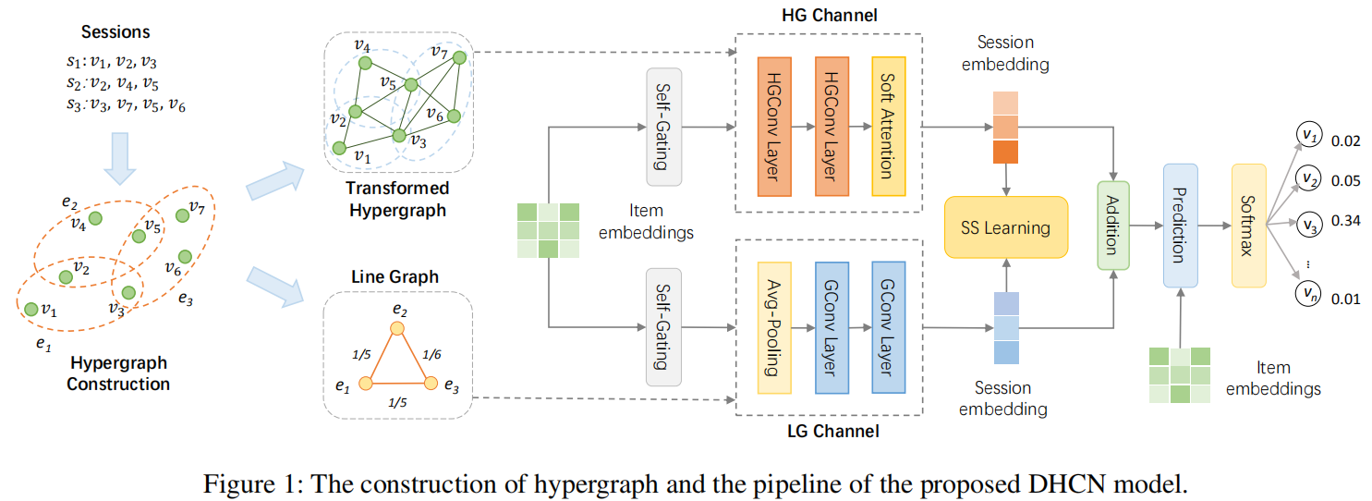
Method
Dual channel Hypergraph Convolutional Network (DHCN)

Slide 5
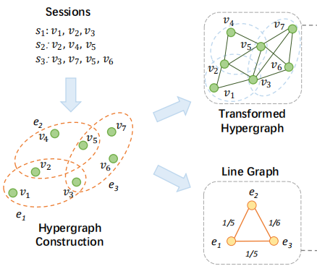
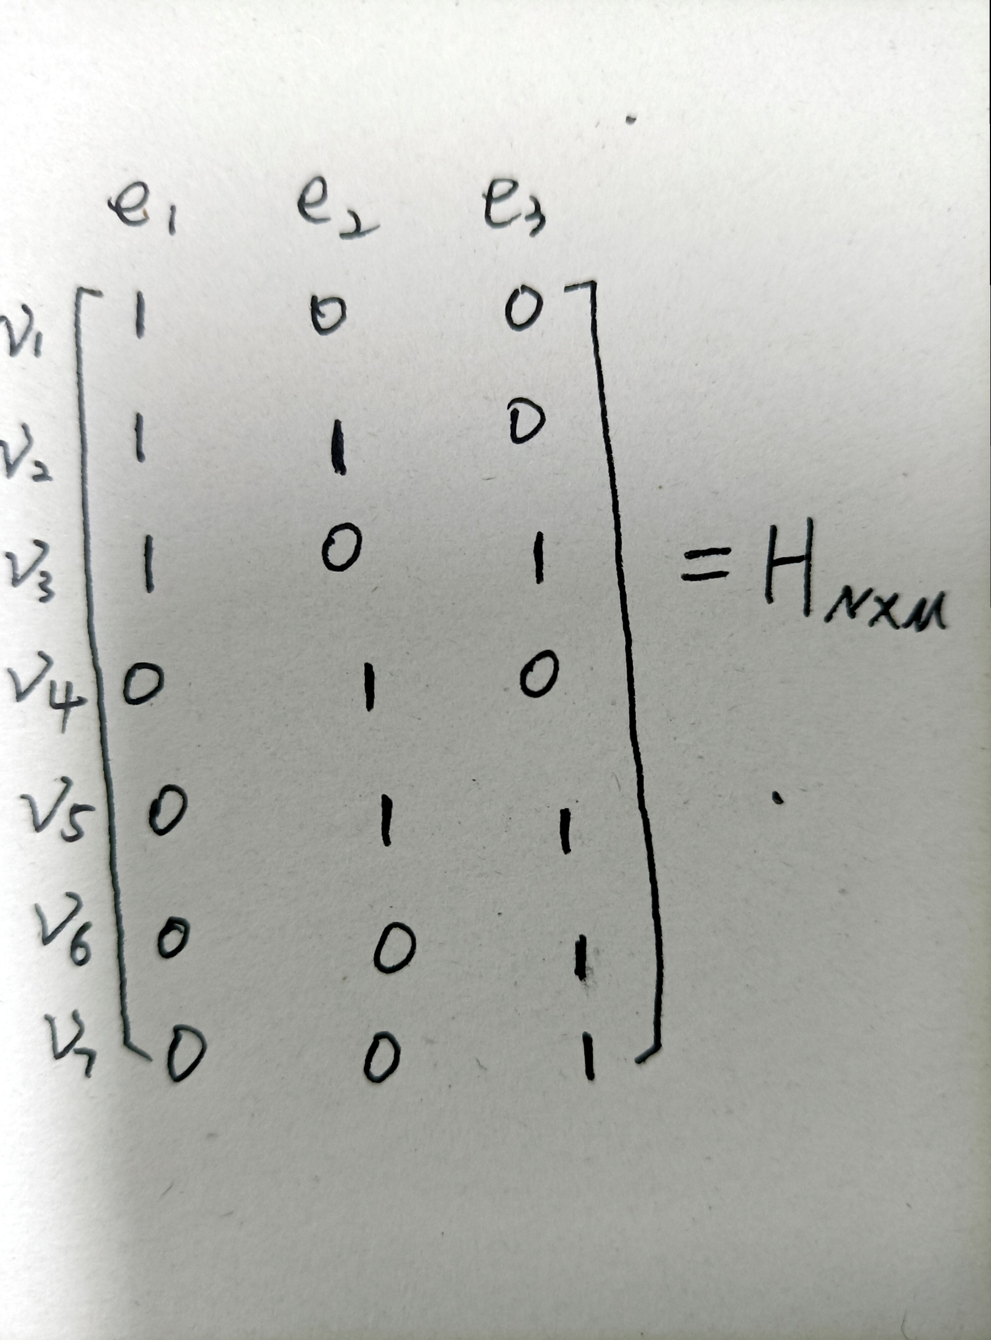
Method
Hypergraph
Hypergraph: Depicting the item-level high-order relations
Incidence matrix
Degree of each vertex and hyperedge :
and are diagonal matrices.

Slide 6
Method
Line graph of Hypergraph
Line graph of hypergraph: Describing the session-level relations
Assigning each edge a weight where

Slide 7
Method
Hypergraph Channel and Convolution.
Pre- filter with self-gating units (SGUs)
Here: =
Final item embeddings:
The embeddings of items’ propagating:
The embedding of session:
The matrix form of Eq. (1) with row normalization is:

Slide 8
Method
Line Graph Channel and Convolution
Pre- filter with self-gating units (SGUs)
Here: =
The channel-specific session embeddings :
${Θ_{l}}_{i}^{(0)}=\frac{1}{\left|s_{i}\right|}\sum_{x_{l_{j}}^{\left(0\right)}∈S_{i}}{x_{l_{j}}^{\left(0\right)}}$, $x_{l_{j}}^{\left(0\right)}∈$
Line graph convolution:
Incident matrix of :
Final session embeddings :
is a diagonal degree matrix where:

Slide 9
Method
Model Optimization and Recommendation Generation & Self-Supervised Learning
$$L_{s}$$
$$L_{r}$$

Slide 10
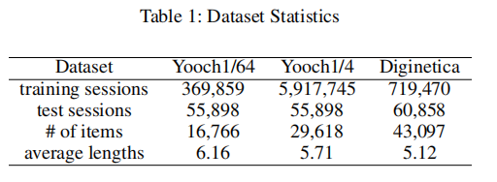
Experiment
Dataset：
Remove all sessions containing only one item and also remove items appearing less than five times.
Augmenting and labeling the dataset by using a sequence splitting method:

Slide 11
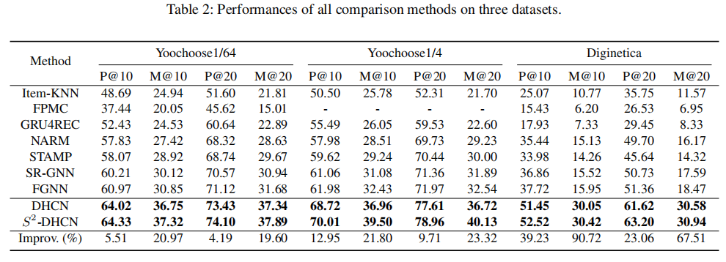
Experiment
Overall Performance.

Slide 12
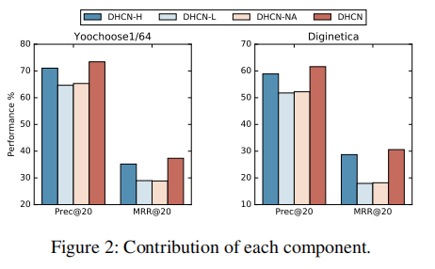
Experiment
Ablation Study

Slide 13
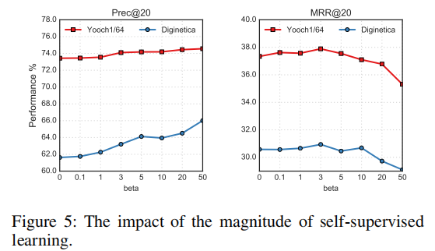
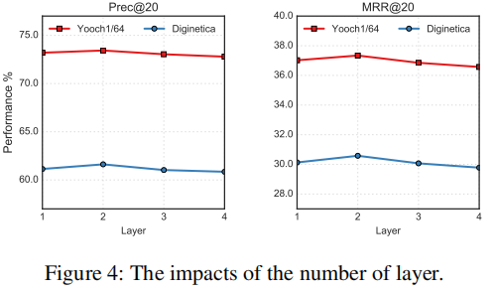
Experiment
Impact of Different Session Lengths.
Impact of Self-Supervised Learning.

Slide 14
Conclusion
Existing GNNs-based SBR models regard the item transitions as pairwise relations, which cannot capture the ubiquitous high-order correlations among items.
In this paper, we propose a dual channel hypergraph convolutional network for SBR to address this problem, Moreover, to further enhance the network, we innovatively integrate self-supervised into the training of the network.
Extensive empirical studies demonstrate the overwhelming superiority of our model, and the ablation study validates the effectiveness and rationale of hypergraph convolution and self-supervised learning.

Slide 15
Chongqing University of Technology
ATAI
Advanced Technique of Artificial Intelligence
Chongqing University of Technology
Thank you!

